Slide 1

Descriptive Statistic
Zain

Slide 2
COVID19 Analysis
Coronaviruses are a large family of viruses which may cause illness in animals or humans. In humans, several coronaviruses are known to cause respiratory infections ranging from the common cold to more severe diseases such as Middle East Respiratory Syndrome (MERS) and Severe Acute Respiratory Syndrome (SARS). The most recently discovered coronavirus causes coronavirus disease COVID-19 - World Health Organization

Slide 3
Aim
To analyze Data
To find anomalies
To preprocess data
To cleanse the data
To provide the insights on data with different visualization

Slide 4
Case
To provide detailed insight on covid cases in various dimensions like
Date wise
Region wise
Gender wise

Slide 5
Audience
Government officials
Pharma companies
Doctors
Research institutes

Slide 6
Nature of Data
We have data in three flavours
Vaccination details
Testing details
Overview data
Around 6000 records ,mainly 2 categories (date and state) , few discrepancies detected like (null values , duplicate values , invalid values with *) , numerical data is contentious

Slide 7
Visual Insights - Confirmed
Top 10 Confirmed Cases
Highest Confirmed Cases in Kerala

Slide 8
Visual Insights - Cured
Top 10 Cured Cases
Highest Cured Cases in Maharashtra

Slide 9
Visual Insights - Positive Case
Highest Cases recorded in August
Lowest in March

Slide 10
Visual Insights - Cases Age wise
Highest affected 45-60 age group

Slide 11
Visual Insights - Vaccination
Highest Vaccination in June

Slide 12
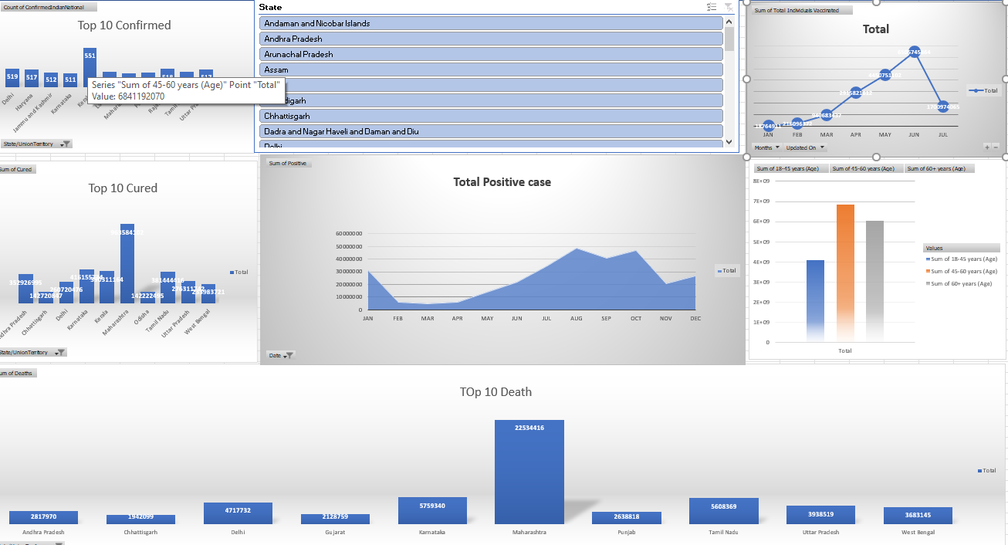
Visual Insights - Overall

